Slide 1





Name a Tune
DIRECTIONS
PLANES

Slide 2
Introduction to Veterinary Medical Terminology
BODY PLANES

Slide 3
Outline
Review Directional Terms
Body Planes
III. Gummi Bear Dissection Lab
IV. Review Quiz

Slide 4
Common Terms for Body Parts
Head - cranium
Neck - cervical
Trunk - thorax
Body - Soma
Belly - abdomen
Front/back leg - front/hind; extremities
Paw - carpus/tarsus, metacarpus/metatarsus, phalanges

Slide 5
Root Words
Dors - pertaining to the back (L. dorsum)
Ventr- pertaining to the belly (L. ventrum)
Palm - pertaining to the palm (humans) or sole of the forefeet (animals)
Plant - pertaining to the sole of the hindfeet

Slide 6
Root Words
Later/al - pertaining to the side (L. laterus)
Medi/al - pertaining to the middle
Post - pertaining to the rear
Remember: The key to using directional terminology appropriately is to use a suitable point of reference.

Slide 7
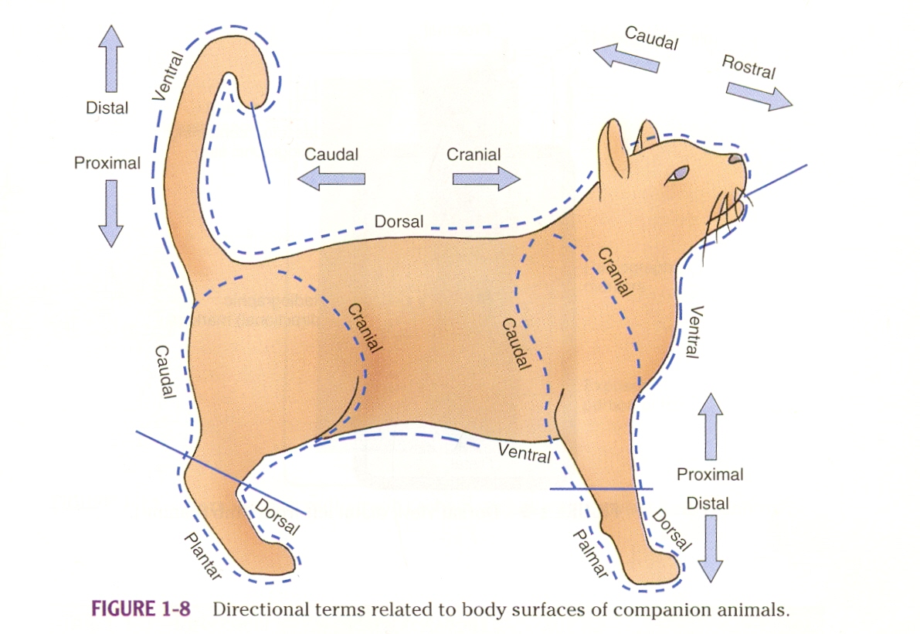
Source: Veterinary Medical Terminology, 2nd edition by Dawn E. Christenson

Slide 8
Source: Veterinary Medical Terminology, 2nd edition by Dawn E. Christenson

Slide 9
Source: Veterinary Medical Terminology, 2nd edition by Dawn E. Christenson

Slide 10
Source: Veterinary Medical Terminology, 2nd edition by Dawn E. Christenson

Slide 11
Source: Veterinary Medical Terminology, 2nd edition by Dawn E. Christenson

Slide 12
Source: Veterinary Medical Terminology, 2nd edition by Dawn E. Christenson

Slide 13
Source: Veterinary Medical Terminology, 2nd edition by Dawn E. Christenson

Slide 14
Body Planes Activity
With your sheet of blank paper.
Fold it into quarters.
For each square:
  Provide a Title
  Provide a definition
  Provide an illustration.

Slide 15
Body Planes
Median
Sagittal
Transverse
Dorsal

Slide 16
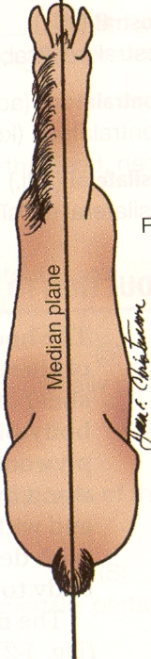
Body Planes
Median Plane
Divides the body from head to tail into 2 equal sides, right and left.
Source: Veterinary Medical Terminology, 2nd edition by Dawn E. Christenson

Slide 17
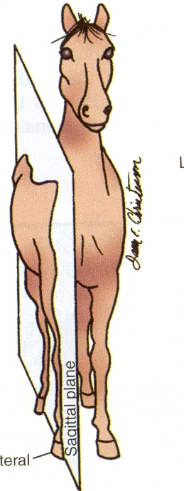
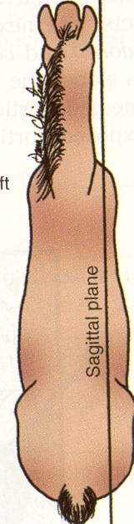
Body Planes
Sagittal Plane
Divides the body from head to tail into 2 (not necessarily into equal sides), right and left.
Source: Veterinary Medical Terminology, 2nd edition by Dawn E. Christenson

Slide 18
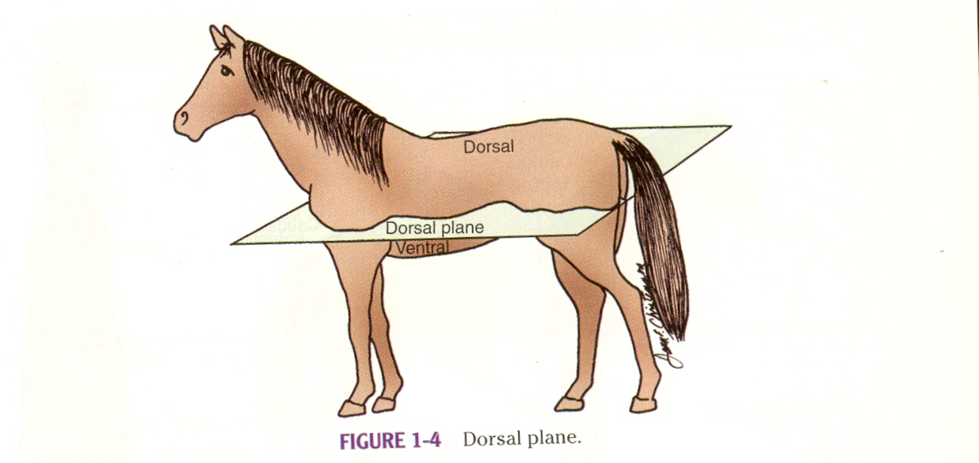
Body Planes
Dorsal plane
-divides the body into dorsal and ventral parts
Source: Veterinary Medical Terminology, 2nd edition by Dawn E. Christenson

Slide 19
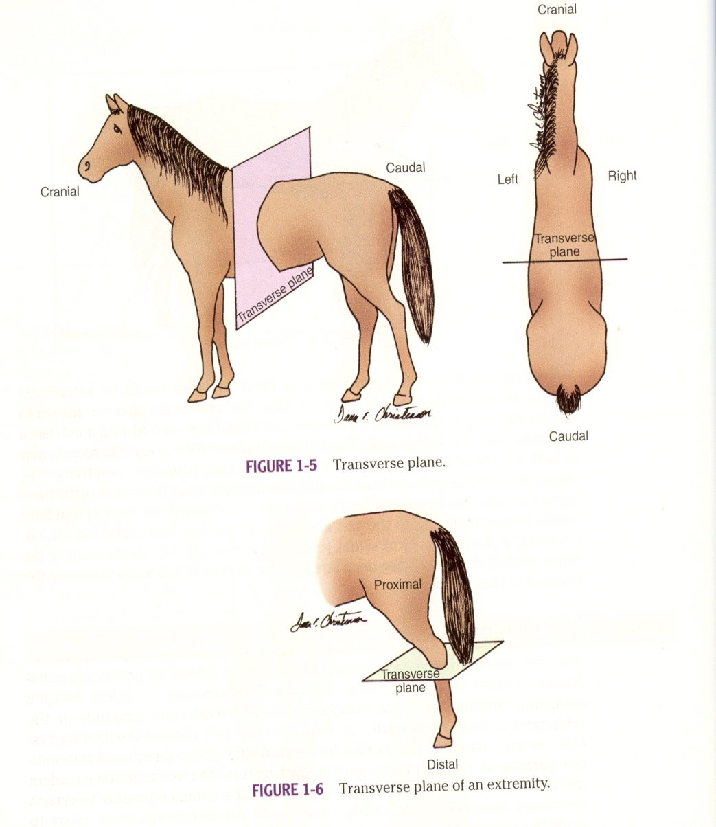
Body Planes
Transverse plane
- divides the body/limb into cranial and caudal portions.
Source: Veterinary Medical Terminology, 2nd edition by Dawn E. Christenson

Slide 20
Body Planes
Median
Sagittal
Transverse
Dorsal

Slide 21
Gummi Bear Lab
For each student:
  1 Lab Sheet
  1 plastic knife
  1 Plate
  1 Napkin
  One Baggie of Gummi Bears

